Slide 2
Concreter met Architectuur
Door: Willem Feijen

Slide 3
Belangrijke functionaliteit groepen
Text to psychology
Sentiment Mining
Emotion Mining
Motivation Mining
Text to Domain Knowledge
Word Inter Distance Model
Sequence to process
Colored Process Mining (visualize aspect in mined process model)
Real time prediction
Predict Sentiment
Predict Emotion
Predict Motivation
Predict Behaviour
Ontwikkelpad:
Sentiment Mining + Colored Process Mining
… + Word Inter Distance Model
… + Emotion Mining
… + ???

Slide 4
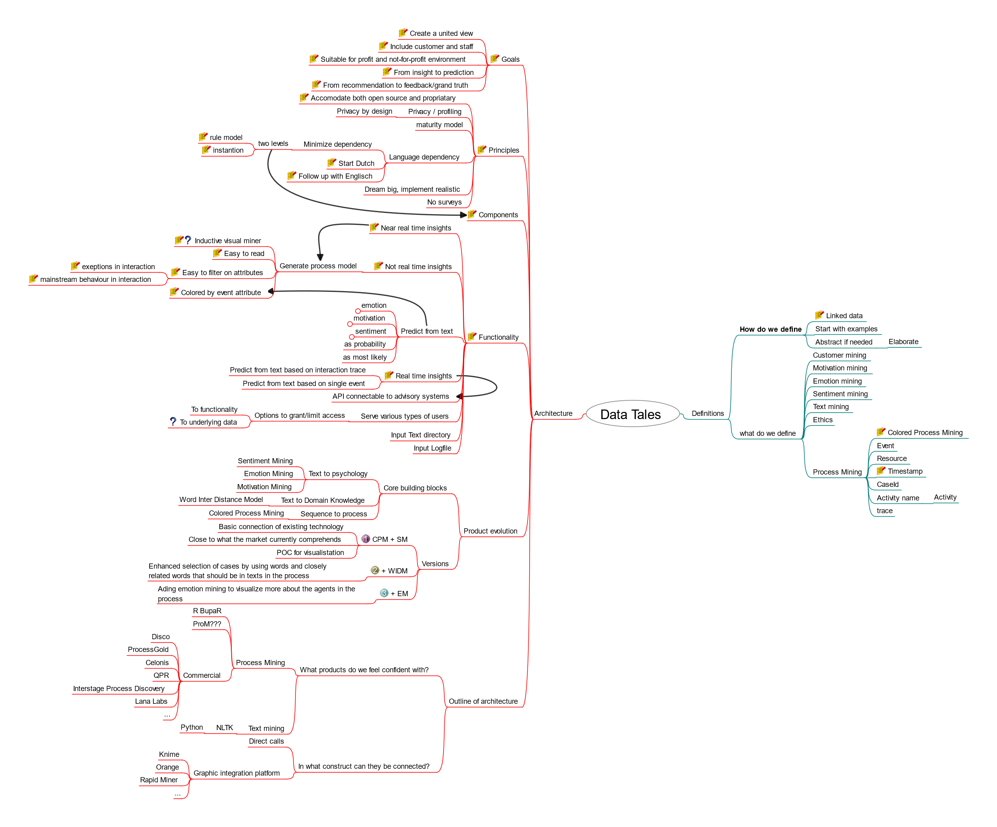
Denken richting tooling

